Slide 1
CPU Scheduling
Hamid R. Zarandi
h_zarandi@aut.ac.ir

Slide 2
Motivation
To make computer more productive
Maximum CPU utilization obtained with multiprogramming
Process scheduling or Thread scheduling
Having different sequence of IO or CPU
CPU–I/O Burst Cycle – Process execution consists of a cycle of CPU execution and I/O wait
CPU burst followed by I/O burst
CPU burst distribution is of main concern

Slide 3
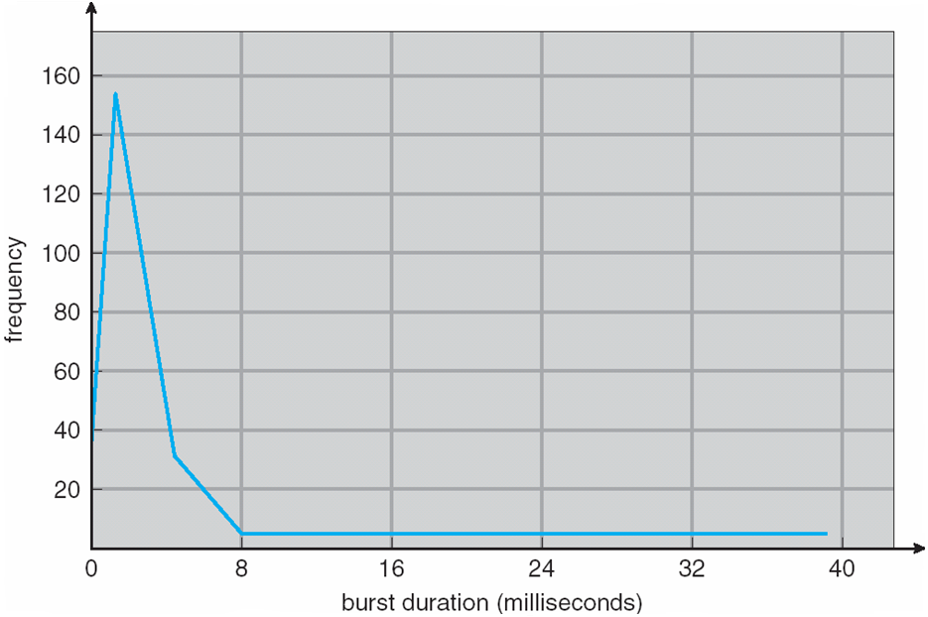
CPU burst curve
Exponential or hyperexponential

Slide 4
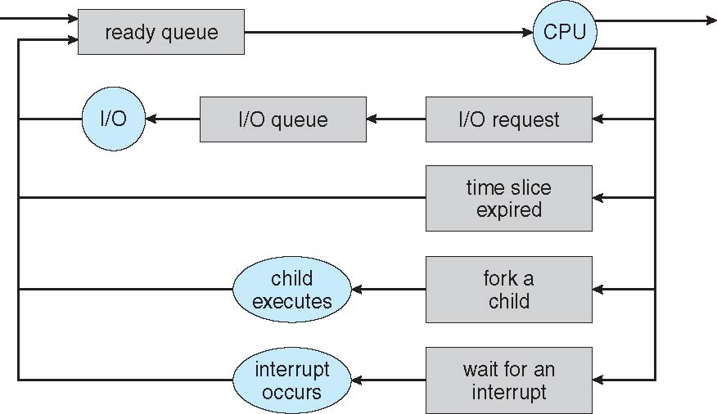
CPU scheduler
Whenever CPU is idle, it must select another process from ready queue (short-term scheduler).
Short-term scheduler selects from among the processes in ready queue, and allocates the CPU to one of them
Ready queue: FIFO, priority queue, tree, unordered linked list!
Consisted of PCBs of processes

Slide 5
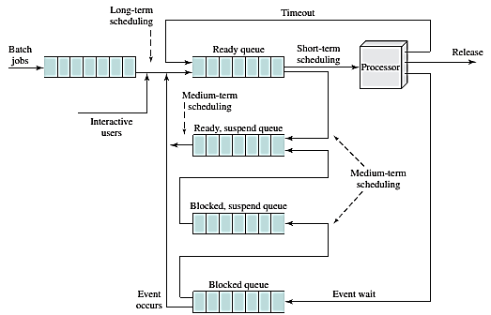
Schedulers

Slide 6
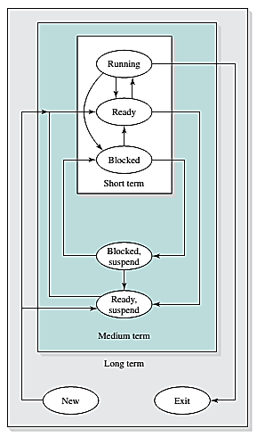
Level of scheduling

Slide 7
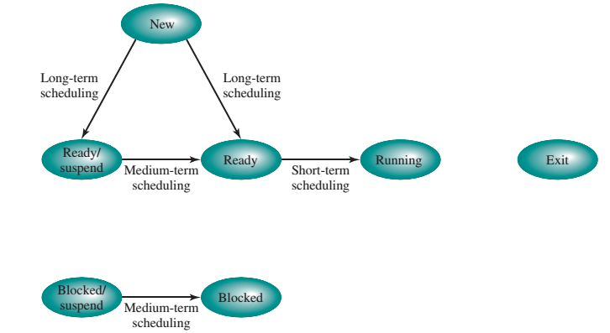
Scheduling and process state transition

Slide 8
Preemption and preemptive scheduling
Preemption
The act of temporarily interrupting a task being carried out by a computer system, without requiring its cooperation, and with the intention of resuming the task at a later time [wiki]
Scheduler
Preemptive vs. Nonpreemptive (cooperative)
When CPU can switch?
A process switches from running → waiting state (IO request, wait())
A process switches from running → ready state (interrupt occurs)
A process switches from waiting → ready state (completion of IO)
A process terminates!
Scheduling under 1 and 4 is nonpreemptive
All other scheduling is preemptive

Slide 9
Which one is good? preemptive or nonpreemptive
Nonpremtive scheduler
Windows 3.1
No need of any special hardware mechanisms (timer, etc.)
Preemptive scheduler
Windows 95, 98, ME, XP, 7, 8, 10
Mac OS X
Can result Race Condition! (why?)

Slide 10
Dispacher
An OS module gives control of CPU to the process selected by short-term scheduler
Switching context
Switching to user mode
Jumping to proper location in the user program to resume it
Should be fast.
Dispatch latency
The time to stop one process and start another running

Slide 11
Which scheduler is the best?
Criteria
CPU utilization
As busy as possible
A value from 0 to 100 (real system 40 to 90)
Throughput
Number of processes that are completed.
Turnaround time
Time from submission of a process to time of completion
Sum of periods spent waiting {to get memory, IO, CPU}, running in CPU, doing IO
Waiting time
Sum of periods spent waiting in the ready queue
Response time
Time from submission of a request until first response is produced.
Time it takes to start responding
Which one is better?

Slide 12
Best scheduler?
For interactive systems (desktop systems)
Minimizing variance in response time
The main question:
Which one of processes in Ready Queue is to be allocated to CPU?

Slide 13
Scheduling Algorithms

Slide 14
1) First-Come, First Served scheduling
Simplest
Average waiting time is much!
Process Burst Time
P₁ 24
P₂ 3
P₃ 3
Suppose that the processes arrive in the order: P₁ , P₂ , P₃ The Gantt Chart for the schedule is:
Waiting time for P₁ = 0; P₂ = 24; P₃ = 27
Average waiting time: (0 + 24 + 27)/3 = 17

Slide 15
1) FCFS Scheduling (Cont.)
Suppose that the processes arrive in the order:
P₂ , P₃ , P₁
Waiting time for P₁ = 6; P₂ = 0; P₃ = 3
Average waiting time: (6 + 0 + 3)/3 = 3
Much better than previous case (why?)
Convoy effect - short process behind long process
Consider one CPU-bound and many I/O-bound processes

Slide 16
2) Shortest-Job-First scheduling
Shortest-next-CPU-burst
Decides based on the length of process’s next CPU burst
Is optimal; has min average waiting time!
It cannot be implemented in short-term scheduler (why?)
ProcessArriva l Time Burst Time
P₁ 0.0 6
P₂ 2.0 8
P₃ 4.0 7
P₄ 5.0 3
SJF scheduling chart
Average waiting time = (3 + 16 + 9 + 0) / 4 = 7

Slide 17
Determining length of next CPU burst
Prediction as exponential average
Commonly, α set to ½
Two implementations: Preemptive, Nonpreemptive
Preemptive SJF: shortest-remaining-time-first

Slide 18
Example

Slide 19
Preemptive SJF
Now we add the concepts of varying arrival times and preemption to the analysis
ProcessA arri Arrival TimeT Burst Time
P₁ 0 8
P₂ 1 4
P₃ 2 9
P₄ 3 5
Preemptive SJF Gantt Chart
Average waiting time = [(10-1)+(1-1)+(17-2)+5-3)]/4 = 26/4 = 6.5 msec

Slide 20
3) Priority scheduling
General case of SJF (how?)
A priority (number) is associated with each process
Internal: time limits, memory requirements, number of open files, ratio of IO burst to average CPU burst
External: outside of OS (importance of process, type of funds being paid, etc)
Can be:
preemptive
nonpreemptive

Slide 21

3) Priority scheduling (cont’d)
Main problem? Indefinite blocking or starvation
Solution? To include aging
ProcessA arri Burst TimeT Priority
P₁ 10 3
P₂ 1 1
P₃ 2 4
P₄ 1 5
P₅ 5 2
Priority scheduling Gantt Chart
Average waiting time = 8.2 msec

Slide 22
4) Round-Robin scheduler
Time quantum = q (time slice)
A small unit of time (usually 10-100 ms)
After this time has elapsed, the process is preempted and added to the end of the ready queue
Small time slice is better or large?
q large ⇒ FIFO
q small ⇒ q must be large with respect to context switch, otherwise overhead is too high
Process Burst Time
P₁ 24
P₂ 3
P₃ 3
The Gantt chart is:
Typically, higher average turnaround than SJF, but better response
q should be large compared to context switch time
q usually 10ms to 100ms, context switch < 10 usec

Slide 23
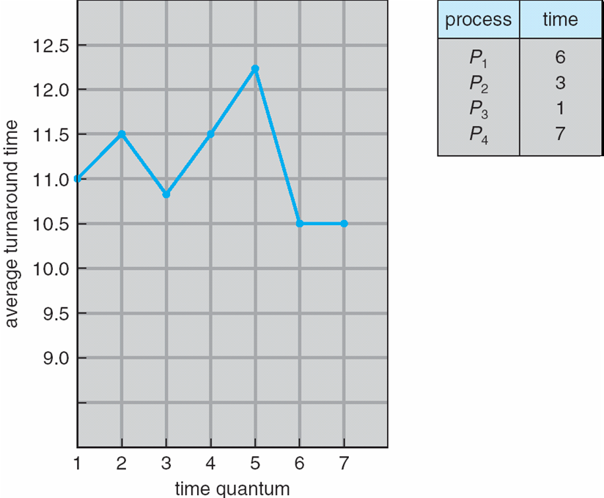
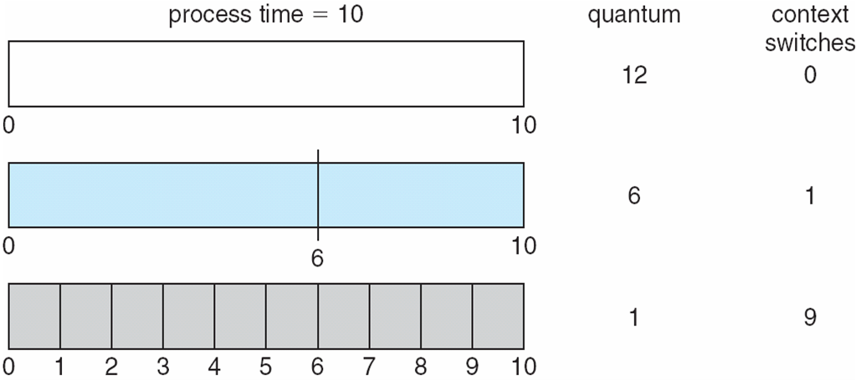
Time quantum & context switch time
80% of CPU bursts should be shorter than q

Slide 24
5) Multilevel Queue scheduler
Ready queue is partitioned into separate queues, eg:
foreground (interactive)
background (batch)
Each queue has its own scheduling algorithm:
foreground – RR
background – FCFS
For example, it has 5 queues:
System processes
Interactive processes
Interactive editing processes
Batch processes
Student processes

Slide 25
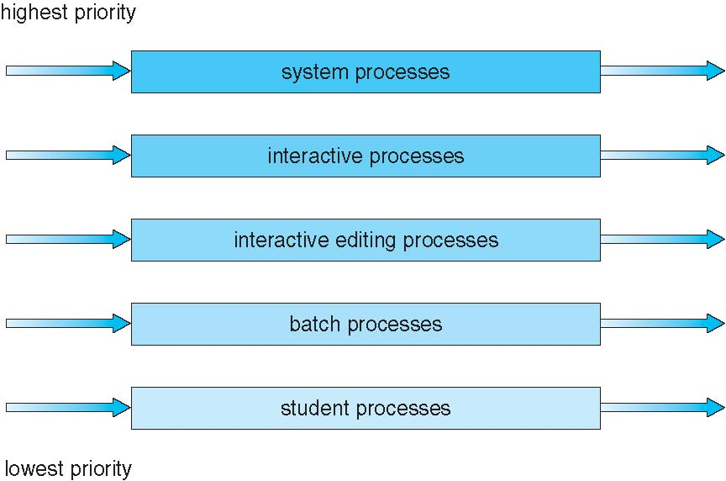
Example of multilevel queue scheduler

Slide 26
6) Multilevel Feedback Queue scheduler
A process can move between the various queues; aging can be implemented this way
Multilevel-feedback-queue scheduler defined by the following parameters:
number of queues
scheduling algorithms for each queue
method used to determine when to upgrade a process
method used to determine when to demote a process
method used to determine which queue a process will enter when that process needs service

Slide 27
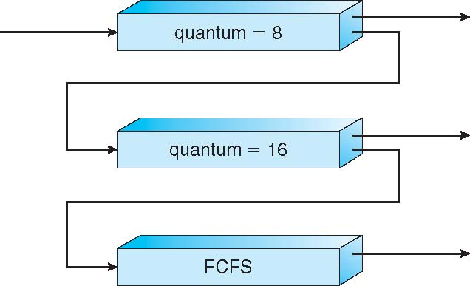
Example of multilevel feedback queue
Three queues:
Q₀ – RR with time quantum 8 milliseconds
Q₁ – RR time quantum 16 milliseconds
Q₂ – FCFS
Scheduling
A new job enters queue Q₀ which is served FCFS
When it gains CPU, job receives 8 milliseconds
If it does not finish in 8 milliseconds, job is moved to queue Q₁
At Q₁ job is again served FCFS and receives 16 additional milliseconds
If it still does not complete, it is preempted and moved to queue Q₂

Slide 28
Multiple Processor Scheduling

Slide 29
Multiple-processor scheduling
Multiple processors
Load sharing
Multiple-processor scheduling
AMP: only one processor accesses the system data structures, alleviating the need for data sharing
Master server (master processor)
SMP
Common ready queue
Private ready queue
Processor affinity: a process has an affinity for the processor on which it is currently running
Soft affinity
Hard affinity
Load balancing
To get best CPU utilization

Slide 30
NUMA and CPU scheduling
Note that memory-placement algorithms can also consider affinity

Slide 31
Load balancing in SMP
If SMP, need to keep all CPUs loaded for efficiency
Load balancing attempts to keep workload evenly distributed
Push migration
Task periodically check the loads on each processor
Pull migration
Idle processor pulls a waiting task
Problem to affinity
Using threshold for imbalancing

Slide 32
Multicore processor
Faster, less power consumption (why?)
Memory stall is costly
Hardware threads for each core
UlteraSPARC T3 CPU (16*8)
Intel Itanium (dual core)
Coarse-grained vs. fine-grained scheduling

Slide 33
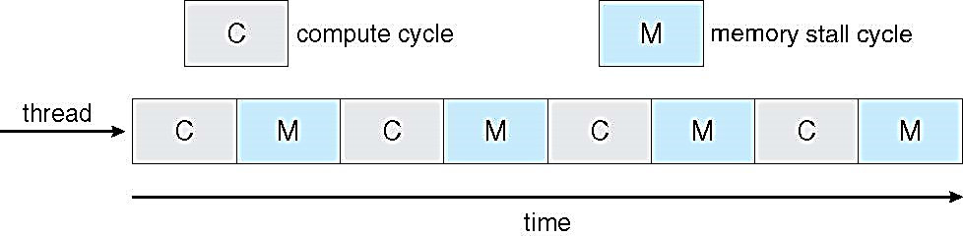

Multithreaded multicore system

Slide 34
Real-Time Scheduling

Slide 35
Real-time CPU scheduling
Events
SW: timer
HW: external interrupts
Soft real-time systems
No guarantee as to when critical real-time process will be scheduled
Guarantee only critical processes have preference over noncritical ones.
Hard real-time systems
Task must be serviced by its deadline
Service after deadline is the same as no service at all.

Slide 36
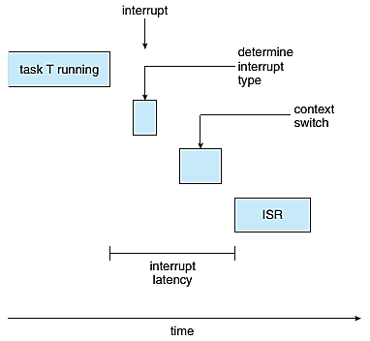
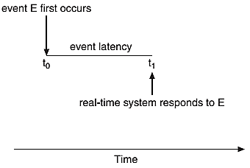
Event latency
Event latency
Time from when an event occurs to when it is serviced
For ABS: 3-5 ms
Interrupt latency
time from arrival of interrupt to start of routine that services interrupt
Dispatch latency
time for schedule to take current process off CPU and switch to another

Slide 37
Dispatch latency
Conflict phase of dispatch latency:
Preemption of any process running in kernel mode
Release by low-priority process of resources needed by high-priority processes

Slide 38
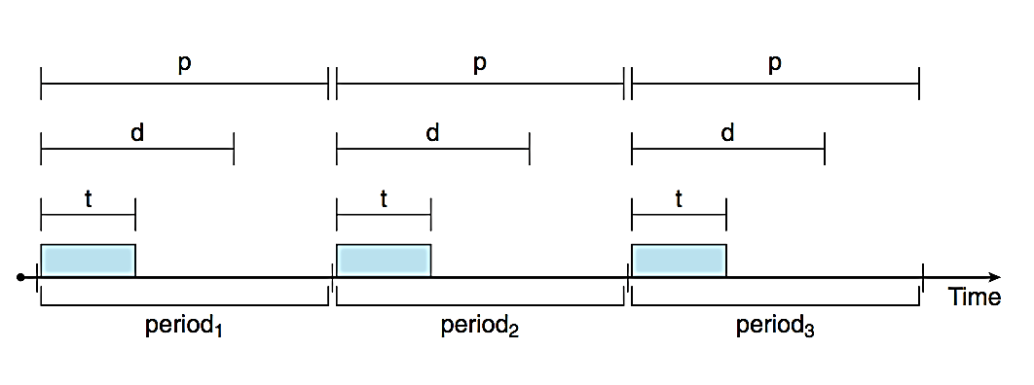
Priority-based scheduling
For real-time scheduling, scheduler must support preemptive, priority-based scheduling
But only guarantees soft real-time
For hard real-time must also provide ability to meet deadlines
Processes have new characteristics: periodic ones require CPU at constant intervals
Has processing time t, deadline d, period p
0 ≤ t ≤ d ≤ p
Rate of periodic task is 1/p

Slide 39
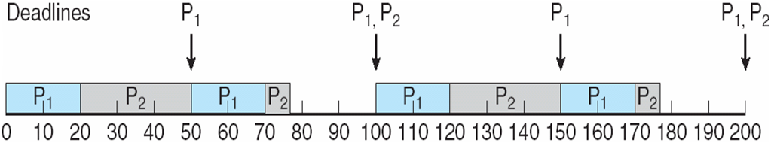
1) Rate-monotonic scheduling
A priority is assigned based on the inverse of its period
Shorter periods = higher priority;
Longer periods = lower priority
P₁ is assigned a higher priority than P₂
ProcessA arri PeriodT CPU burst time Utilization
P₁ 50 20 20/50=0.4
P₂ 100 35 35/100=0.35
__________
total=0.75

Slide 40
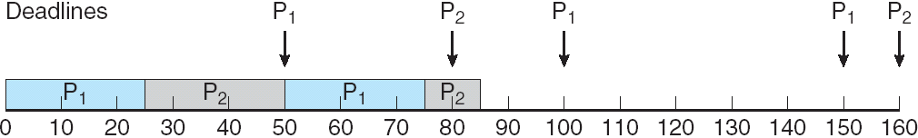
Missed deadlines with Rate Monotonic scheduling
ProcessA arri PeriodT CPU burst time Utilization
P₁ 50 25 25/50=0.5
P₂ 80 35 35/80=0.44
__________
total=0.94

Slide 41
Limitation of CPU utilization in Rate-Monotonic
CPU utilization in RM is bounded!
N=1 → U(1) = 100%
N=2 → U(2) = 83%
N=inf → U(inf) = 69%
U_{max}(N) = N (2^{1/N}-1)

Slide 42
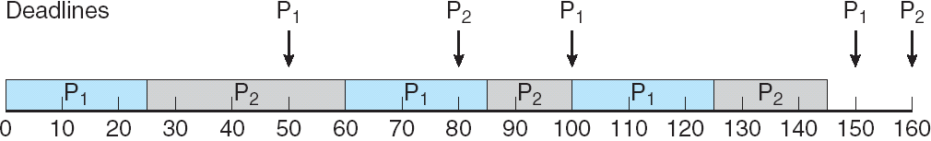
2) Earliest-deadline-first scheduling (EDF)
Priorities are assigned according to deadlines: the earlier the deadline, the higher the priority;
the later the deadline, the lower the priority
ProcessA arri PeriodT CPU burst time Utilization
P₁ 50 25 25/50=0.5
P₂ 80 35 35/80=0.44
__________
total=0.94

Slide 43
3) Proportional share scheduling
T shares are allocated among all processes in the system
An application receives N shares where N < T
This ensures each application will receive N / T of the total processor time

Slide 44
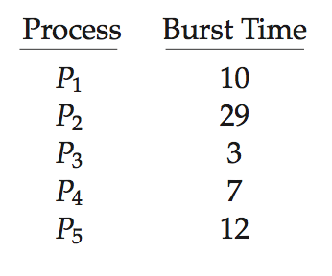
Algorithm evaluation
How to select CPU-scheduling algorithm for an OS?
Determine criteria, then evaluate algorithms
_{Deterministic modeling}
_{FCS is 28ms}
_{Non-preemptive SFJ is 13ms}
_{RR is 23ms}
_{Queueing models}
_{n = average queue length}
W = average waiting time in queue
λ = average arrival rate into queue
Little’s law – in steady state, processes leaving queue must equal processes arriving, thus: _{n = λ x W}
_{Simulations}
Programmed model of computer system

Slide 45
Implementation
Even simulations have limited accuracy
Just implement new scheduler and test in real systems
High cost, high risk
Environments vary
Most flexible schedulers can be modified per-site or per-system
Or APIs to modify priorities
But again environments vary

Slide 46

Questions?

